Slide 1
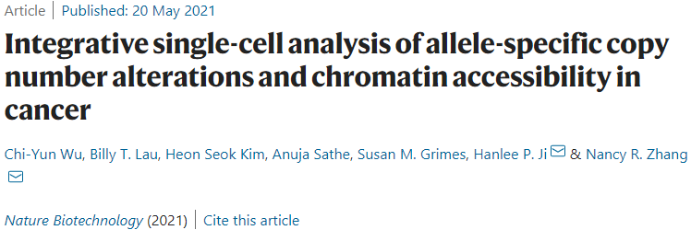
Alleloscope: Capturing DNA copy number alteration and chromatin accessibility
Jaehyoung Hong

Slide 2
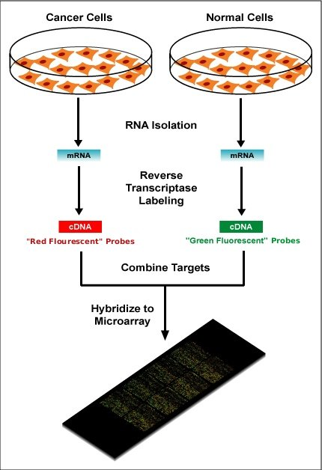

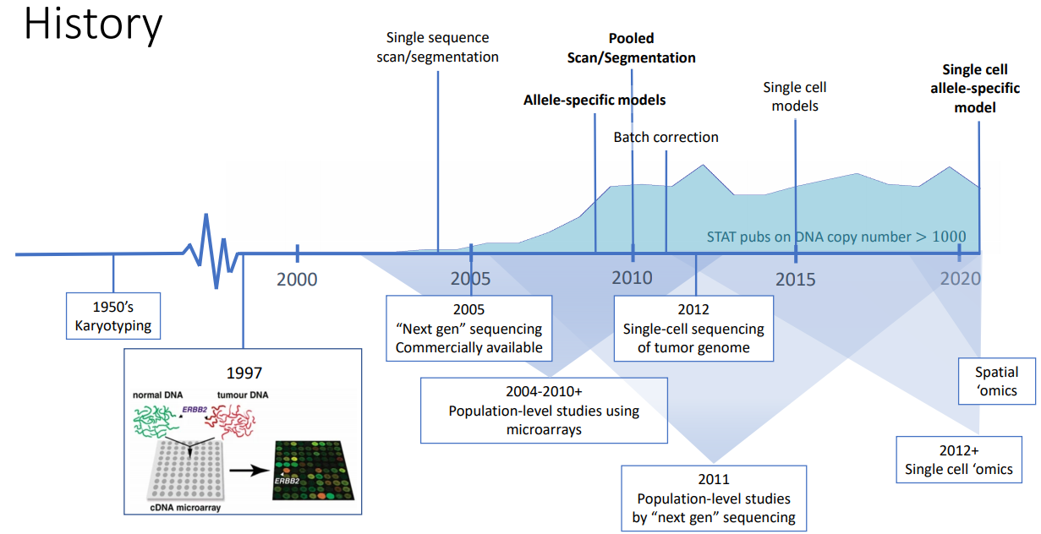
Population level-analysis is not enough for analysis of cancer
Cell is too small
Tumor cell is originated from normal cells
→ Intra-tumor heterogeneity exists
Microarray

Slide 3
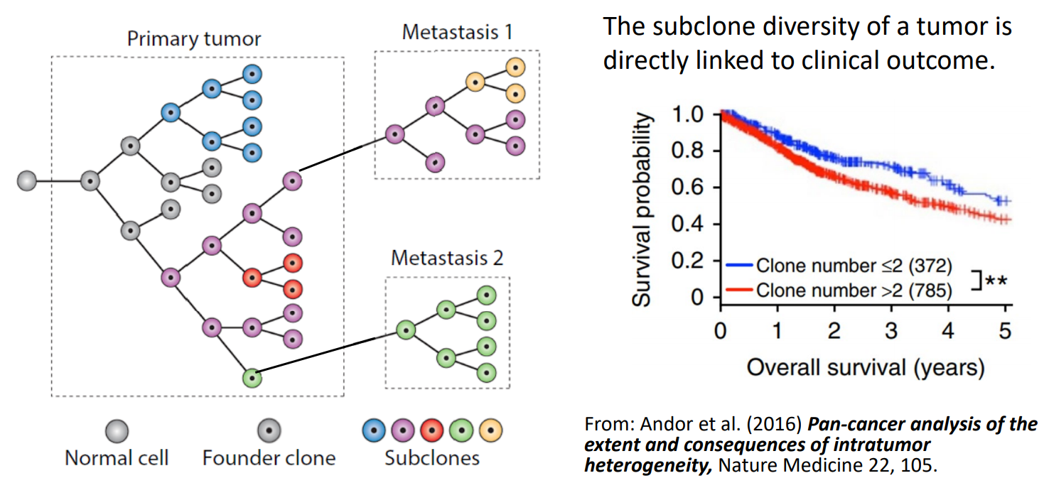
Intra-tumor heterogeneity is important for clinical outcome

Slide 4
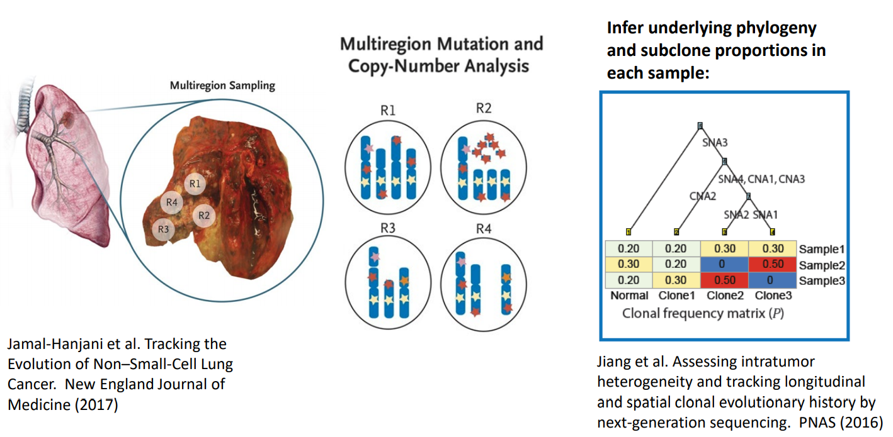
Intra-tumor heterogeneity gives information of clonal evolutionary tree

Slide 5
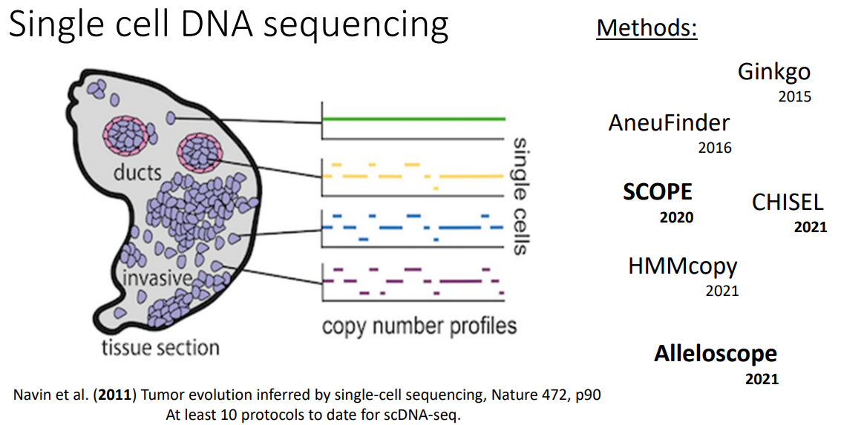
Single-cell sequencing is key for analyzing intra-tumor heterogeneity

Slide 6
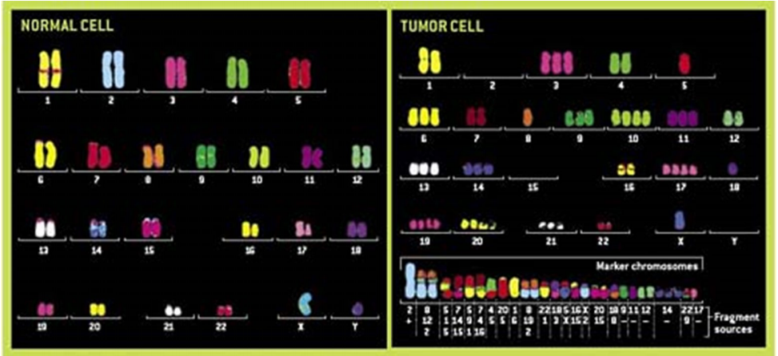


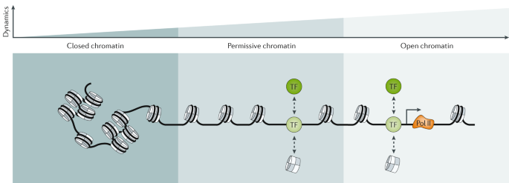
Copy number estimation is needed to analyze scDNA-seq of cancer
1. Copy number aberrations (CNAs)
A
B
B
A
A
B
A
B
B
A
B
B
A
B
2. Chromatin remodeling
Amplification
A
B
B
A
B
B
Deletion
Copy-neutral
'Allele’ specific copy number profiling is needed

Slide 7
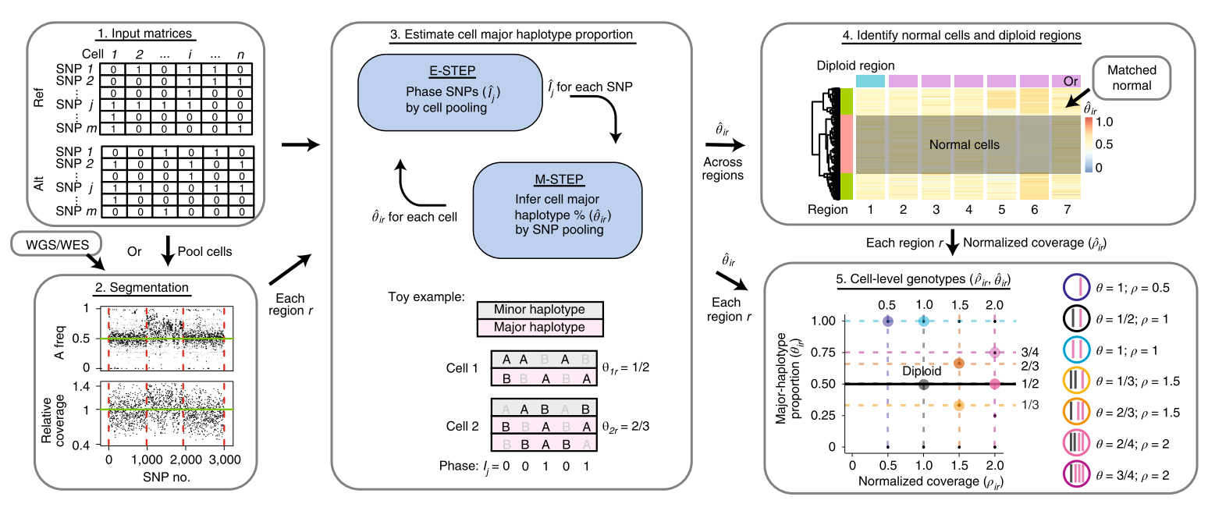
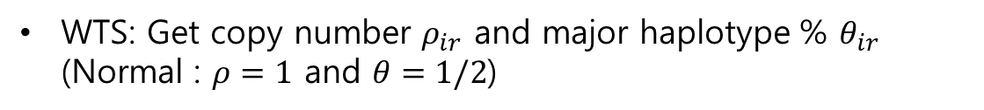
Overview of the “Alleloscope”
WTS: Get copy number $ρ_{ir}$ and major haplotype % $θ_{ir}$ (Normal : $ρ=1$ and $θ=1/2$)

Slide 8
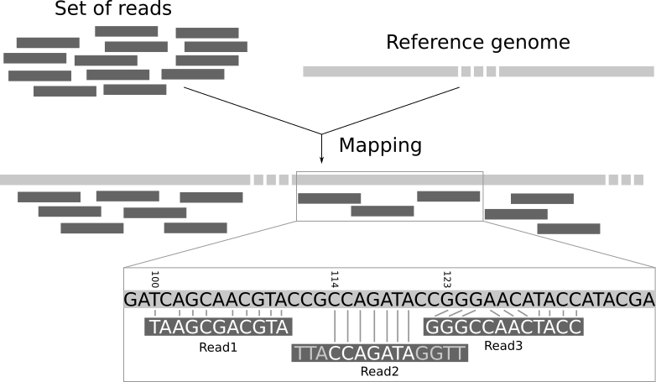
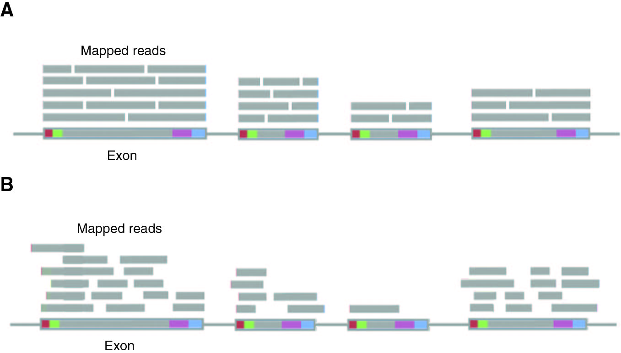
Next generation sequencing requires step of making genome as fragment (Read) which makes bias
Read count1
Read count2
Fragmentation and mapping
Fragmentation makes error
→ Read count gives information of CNA but not exact value
Reads are usually overlapped
(We need to amplify genome in single cell before fragmentation)

Slide 9
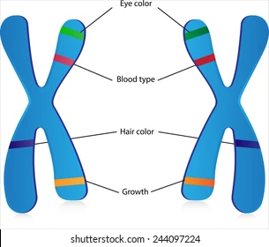
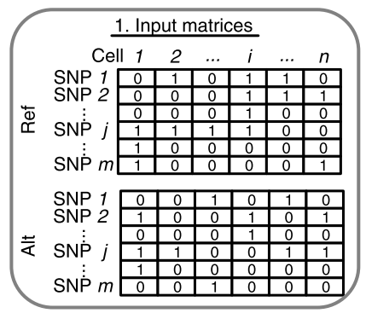
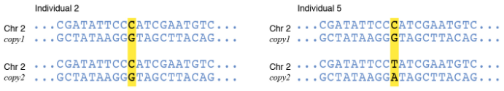
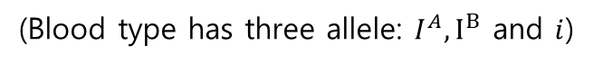
Overview of input matrix
Allele: Variants form of Gene
(Blood type has three allele: $I^{A}, I^{B}$ and $i$)
Normal cells have two haplotypes from each patient
A
B
B
B
Haplotype1
Father
B
A
A
A
Haplotype2
Mother
SNP: Places in the genome where people differ
This is read count so I think matrix should not have 0,1 only
Reference allele and Alternative allele (Hyper parameter?)
Note that Allele of SNP should be two types (AT, GC)
+Allelic imbalance in SNP denotes high risk of disease or SNV which caused by somatic mutation

Slide 10
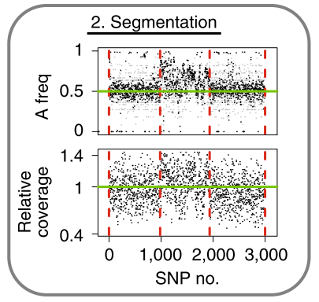
Overview of segmentation: HMM model based calculation
Amplification
If matched normal sample is available:
Segmentation is given by FACLON
If matched normal sample is not available:
HMM model based calculation
Find the region (cluster) where Copy number aberration (CNA) occurs

Slide 11
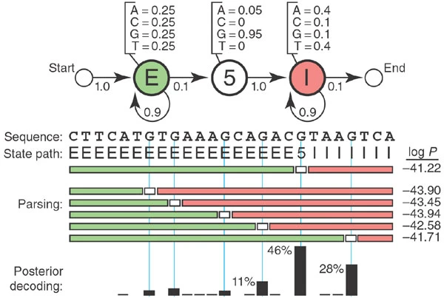
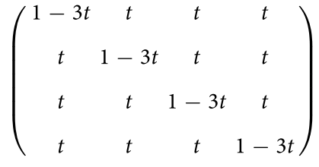
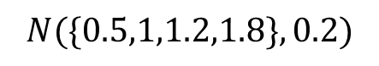
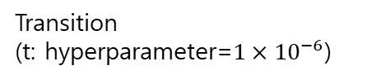
Overview of segmentation: HMM model based calculation
If matched normal sample is not available:
HMM model based calculation
Now we have count for each SNP (pooled)
Observation: #(SNP1)→#(SNP2)→#(SNP3)
Emission
Hidden state: Deletion, Copy-neutral, Amplification, Double-amplification (Read count reflects Copy number)
Observation
Transition
Transition
(t: hyperparameter=$1×{10}^{−6}$)
Hidden
Parsing gives segmentation
Note that observation is count (continuous)
$$N(\{0.5,1,1.2,1.8\},0.2)$$
Example of HMM model used for DNA labelling
Emission

Slide 12
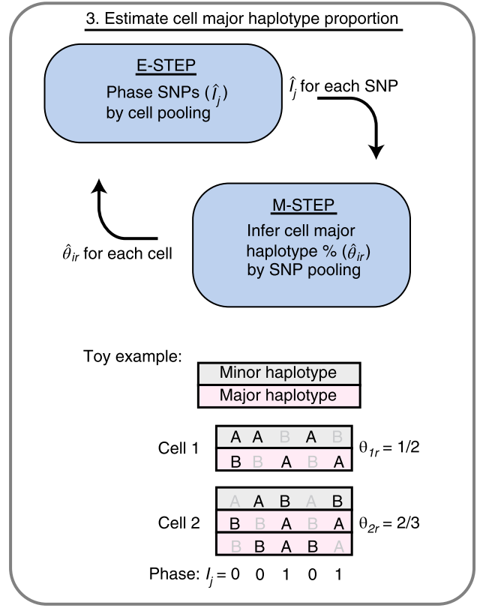
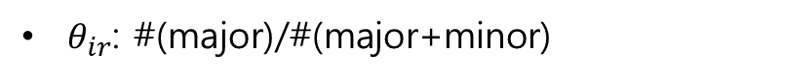
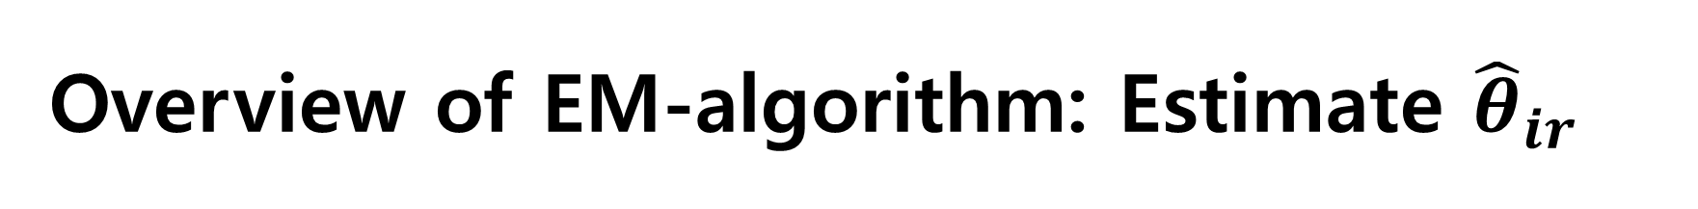
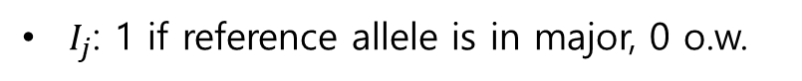
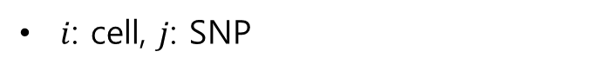

Overview of EM-algorithm: Estimate ${\hat{θ}}_{ir}$
For fixed segmented region $r$
$i$: cell, $j$: SNP
Major haplotype: Haplotype with higher copy number in whole cell
$I_{j}$: 1 if reference allele is in major, 0 o.w.
$θ_{ir}$: #(major)/#(major+minor)

Slide 13
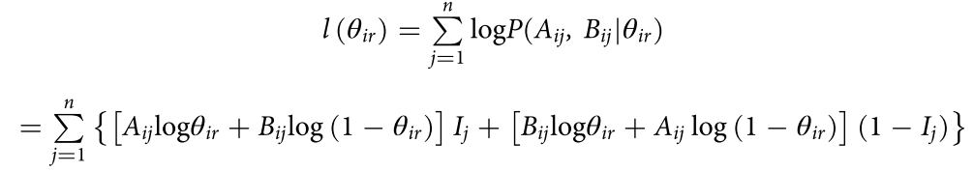
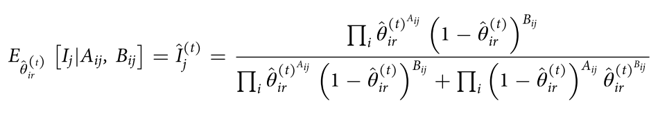
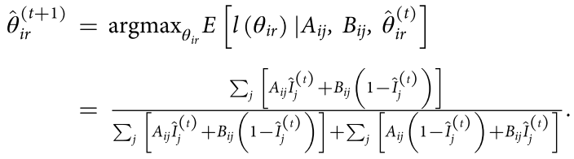
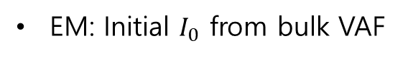
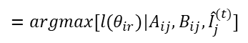
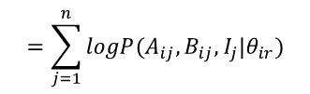
Overview of EM-algorithm: Estimate ${\hat{θ}}_{ir}$
Complete log-likelihood
$$=\sum_{j=1}^{n}{logP(A_{ij},B_{ij},I_{j}|θ_{ir})}$$
$A_{ij},B_{ij}$ : Read count of reference allele and alternative
EM: Initial $I_{0}$ from bulk VAF
$$=argmax[l(θ_{ir})|A_{ij},B_{ij},{\hat{I}}_{j}^{(t)}]$$

Slide 14
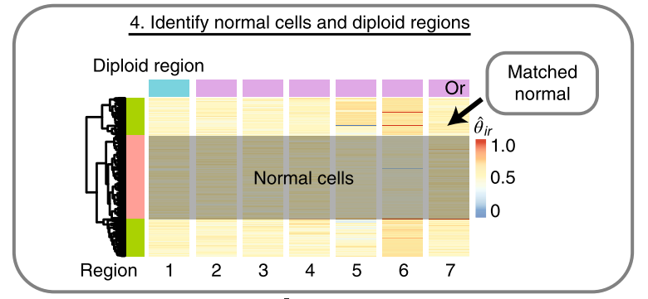

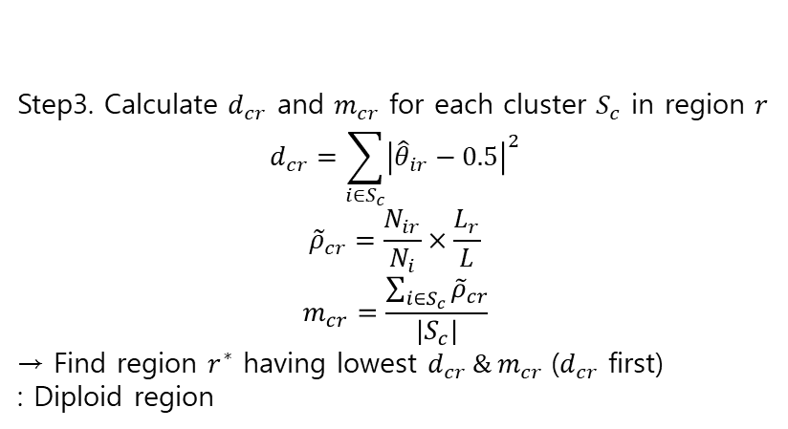
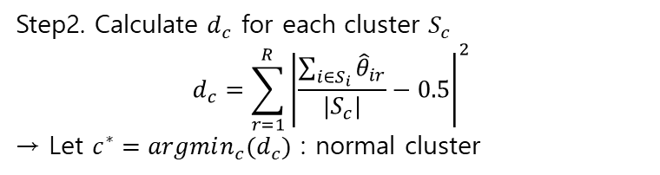
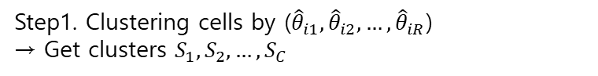
Overview of estimation of coverage statistic ${\tilde{ρ}}_{ir}$ (Make base normal)
Step1. Clustering cells by (${\hat{θ}}_{i1},{\hat{θ}}_{i2},…,{\hat{θ}}_{iR}$)
→ Get clusters $S_{1},S_{2},…,S_{C}$
Step2. Calculate $d_{c}$ for each cluster $S_{c}$
$$d_{c}={\sum_{r=1}^{R}{\left|\frac{\sum_{i∈S_{i}}{{\hat{θ}}_{ir}}}{{|S}_{c}|}−0.5\right|}}^{2}$$
→ Let $c^{∗}=argmin_{c}{(d}_{c})$ : normal cluster
Allelic imbalance
Step3. Calculate $d_{cr}$ and $m_{cr}$ for each cluster $S_{c}$ in region $r$
$$d_{cr}=\sum_{i∈S_{c}}{{\left|{\hat{θ}}_{ir}−0.5\right|}^{2}}$$
$${\tilde{ρ}}_{cr}=\frac{N_{ir}}{N_{i}}×\frac{L_{r}}{L}$$
$$m_{cr}=\frac{\sum_{i∈S_{c}}{{\tilde{ρ}}_{cr}}}{|S_{c}|}$$
→ Find region $r^{∗}$ having lowest $d_{cr} \& m_{cr}$($d_{cr}$ first)
: Diploid region
Allelic imbalance
N: read count & L: length
Over 99% tile → 99% tile value

Slide 15
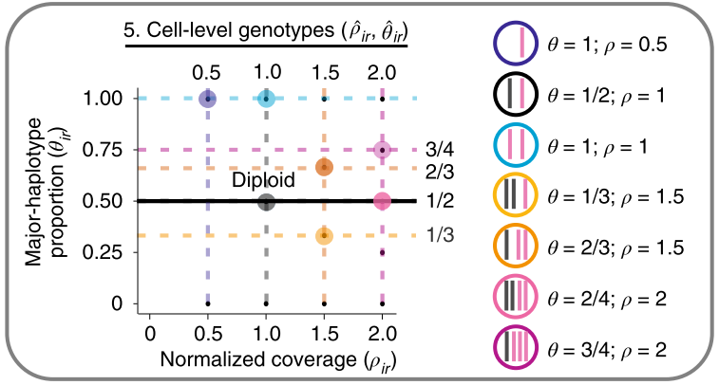
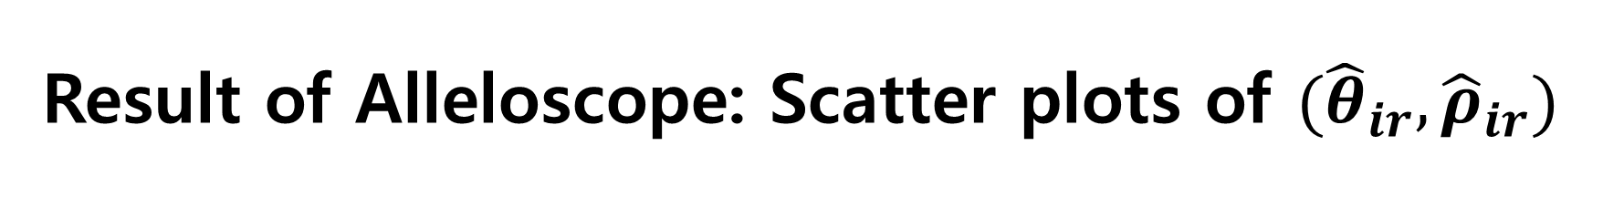
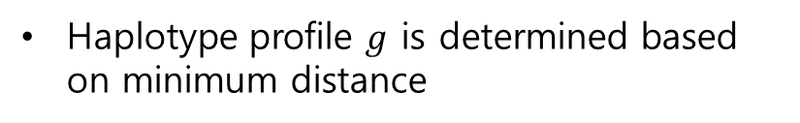
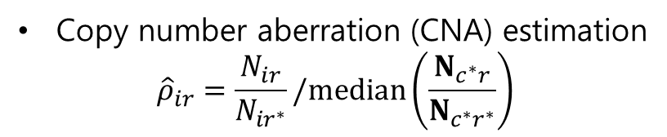
Result of Alleloscope: Scatter plots of $({\hat{θ}}_{ir},{\hat{ρ}}_{ir})$
Copy number aberration (CNA) estimation
$${\hat{ρ}}_{ir}=\frac{N_{ir}}{N_{ir^{∗}}}/median\left(\frac{N_{c^{∗}r}}{N_{c^{∗}r^{∗}}}\right)$$
If more copy number than diploid has higher value
Normalization by normal cell
Note that if normal cell or normal region ${\hat{ρ}}_{ir}≈1$
Haplotype profile $g$ is determined based on minimum distance
Cell and region specific profiles
Cell&region-specific rather than allele-specific?
Definition of Major Haplotype needed?

Slide 16
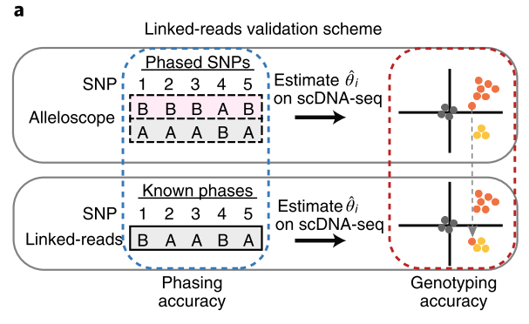
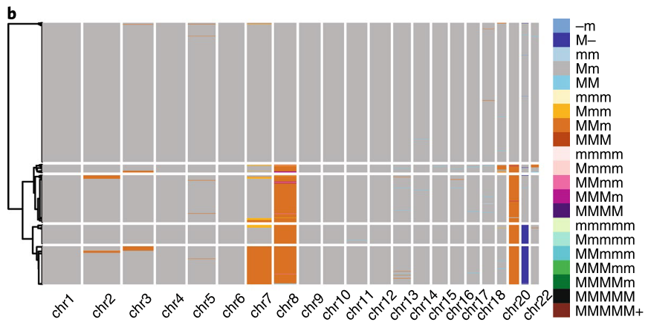
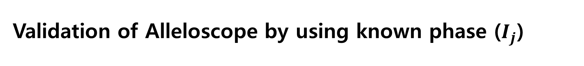
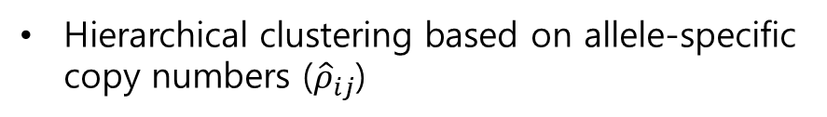
Validation of Alleloscope by using known phase ($I_{j}$)
Data1. scDNA-seq
Data2. scDNA-seq with known phase by linked-reads
→ Gold standard
Hierarchical clustering based on allele-specific copy numbers (${\hat{ρ}}_{ij}$)
Choose chr7, chr8, chr20, chr21

Slide 17
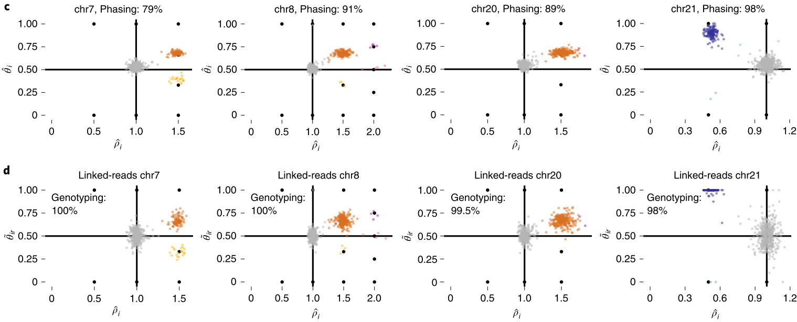
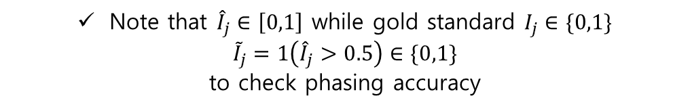
Alleloscope shows high accuracy for estimating phase
True phase is known, but was not used for Alleloscope
Color denotes each genotype
Note that ${\hat{I}}_{j}∈\left[0,1\right]$ while gold standard $I_{j}∈\{0,1\}$
$${\tilde{I}}_{j}=1\left({\hat{I}}_{j}>0.5\right)∈\{0,1\}$$
to check phasing accuracy

Slide 18
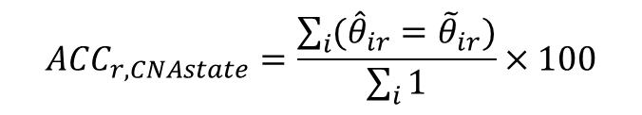
Alleloscope is robust to errors in phasing
Mirrored event
${\tilde{θ}}_{ir}$ is calculated from known phase
$$ACC_{r,CNAstate}=\frac{\sum_{i}{({\hat{θ}}_{ir}={\tilde{θ}}_{ir})}}{\sum_{i}{1}}×100$$
Copy-number estimation of Alleloscope is robust to errors in phasing (to a degree)
Copy-number estimation of Alleloscope has higher sensitivity and specificity than CHISEL
Color denotes genotype inferred from Alleloscope without phase information

Slide 19
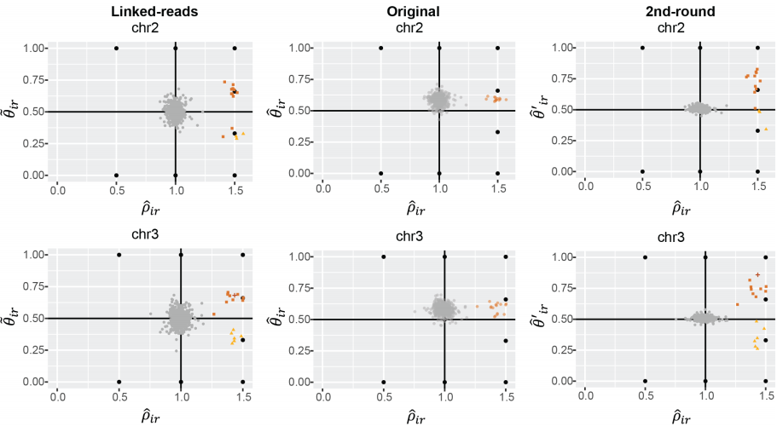
Allescope can detect rare mirrored events

Slide 20
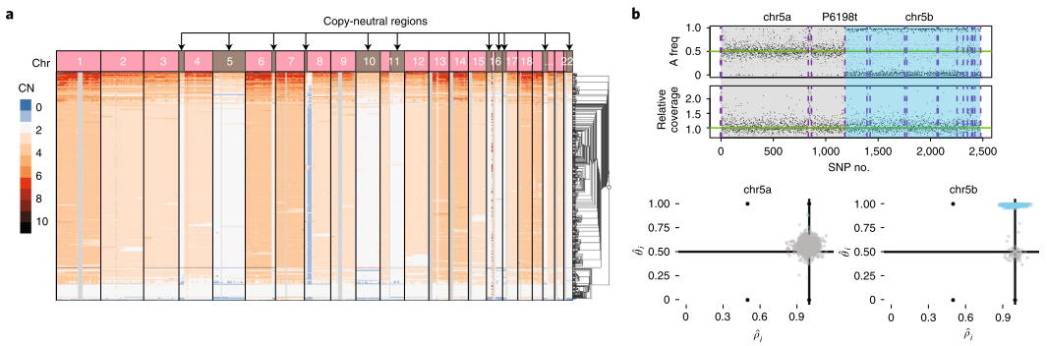
Alleloscope can detect copy-neutral LOH

Slide 21
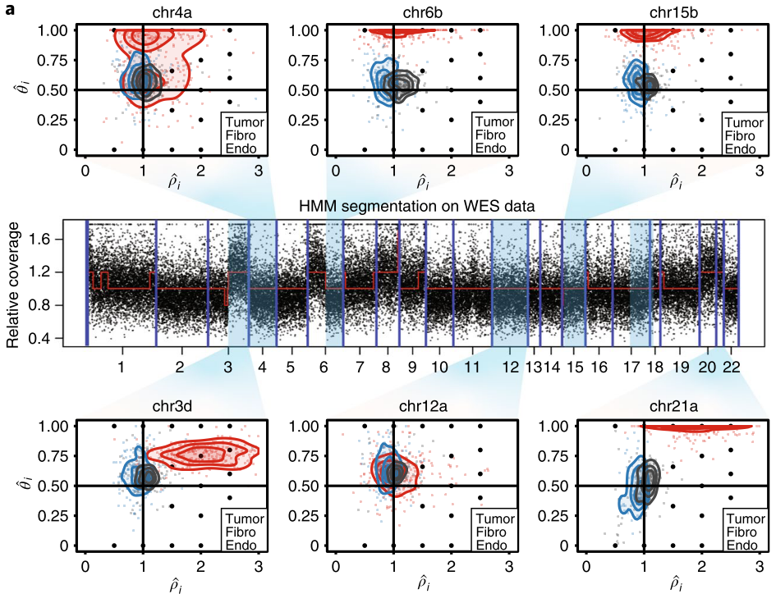

Alleloscope may detect more information with scATAC-seq
scATAC-seq has ‘peak’ data which reflects the chromatin accessibility
Umap based on ‘peak’ data gives three clusters (Tumor: red, Fibro: Black, Endo: blue)
Alleloscope result captures the peak based clusters

Slide 22



Combine peak signal (Chromatin accessibility) from scATAC-seq with Alleloscope
Step1. scATAC-seq with matched scDNA-sea or bulk DNA-seq find subclone based on genotype from ($({\hat{ρ}}_{i},{\hat{θ}}_{i})$)
Marker regions
Step2. Using peak-by-cell matrix from scATAC-seq, we can make evolutionary tree and sub-sub clone (Using Umap with peak data)

Slide 23



Alleloscope results discriminate normal cells and tumor cells (+copy-neutral LOH)
Hierarchical clustering based on ${\hat{θ}}_{i}$

Slide 24




Peak clustering and ${\hat{θ}}_{i}$ shows hint for evolutionary tree
peak1
peak2
Umap for whole cells
Umap for only tumor cells
${\hat{θ}}_{i}$ for two clusters in tumor cells
Note that copy neutral-LOH increase ${\hat{θ}}_{i,4a}$ so that peaks2 has most of copy neutral event
Umap is done with peak data

Slide 25

Evolutionary tree using Alleloscope with scATAC-seq
Peak2&Clone2
Peak1&Clone1
Peak1&Clone2
Chr4a CNA is occurred after other chromosome CNA
Delineate peak difference caused by CNA and Non-CNA
Chr4a got chromatin remodeling after CNA

Slide 26

Comprehensive analysis of evolutionary tree of six subclones of SNU801

Slide 27

Rule1. Parsimony: the tree with the least number of copy number events is preferred
Rule2. Monotonicity: escalating amplifications were occurred with monotonic order (Mm→Mmm→Mmmm) unless a genomic doubling (Mm→MMmm→MMm is available)
Rule3. Irreversibility of LOH: completely loss of allele, it can no longer gain it back
(Mm→MM→MMm is not allowed)
Umap by peak data shows chromatin accessibility diversity in each clone
DAP: Differentially accessible peaks
(Using statistical test introduced in this paper)
After adjusting Copy number, many DAP disappear (CNA is critical way for chromatin remodeling)
Sometimes DAP appears after adjustment
Evolutionary tree which delineates CNA and DAP

